Slide 1
Introduction to CNN
Vraj Suratwala
Department of ICT, VNSGU

Slide 2
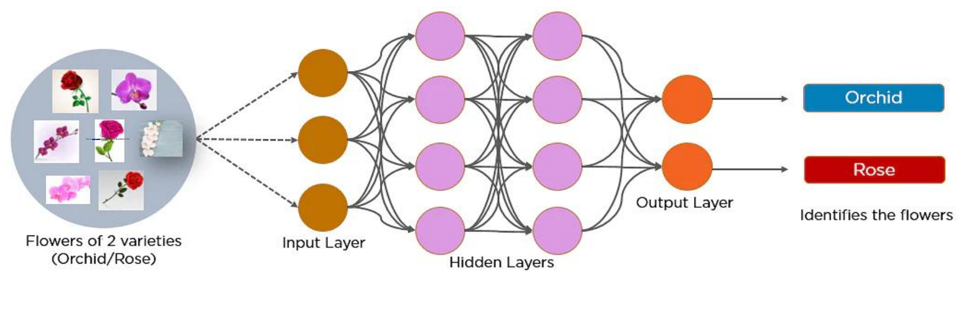
Convolutional Neural Network
A CNN is a Feed Forward Network (FNN) which is basically used to process visuals by making the grid like topology on the visuals.
It is also known as ConvoNET.
Basically it is used to Detect and Classifiy the Object or Anything other feature from Visual Aids.
it is basically working on correlation between the features & nighborhood.

Slide 3
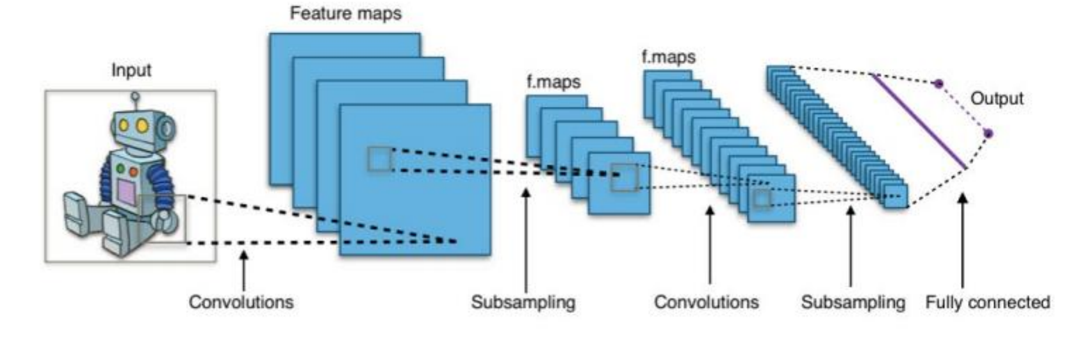
Basic Architecture Understanding

Slide 4
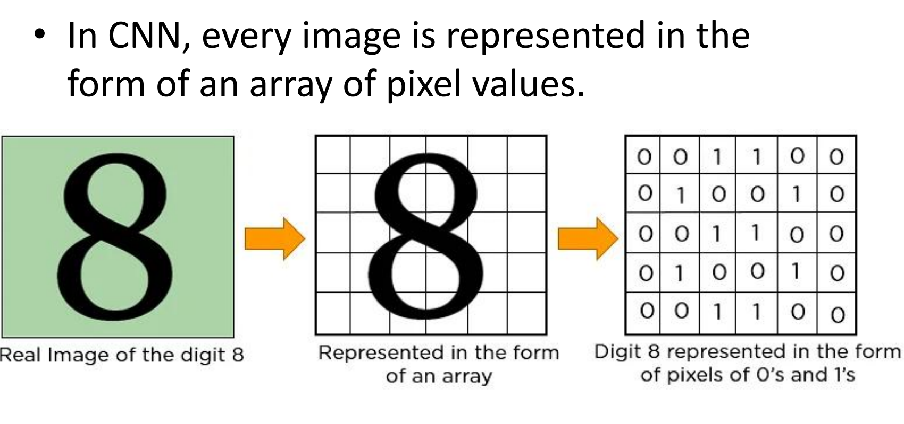
Pixel Format

Slide 5
Layers in Convolutional Network
Basically it is working with multiple hidden layers to extract the feature and meaning from an image and Establish the Co-Relation Between them.
1. Convolutional Layer
2. ReLu Layer
3. Pooling Layer
4. Fully Connected Layer

Slide 6
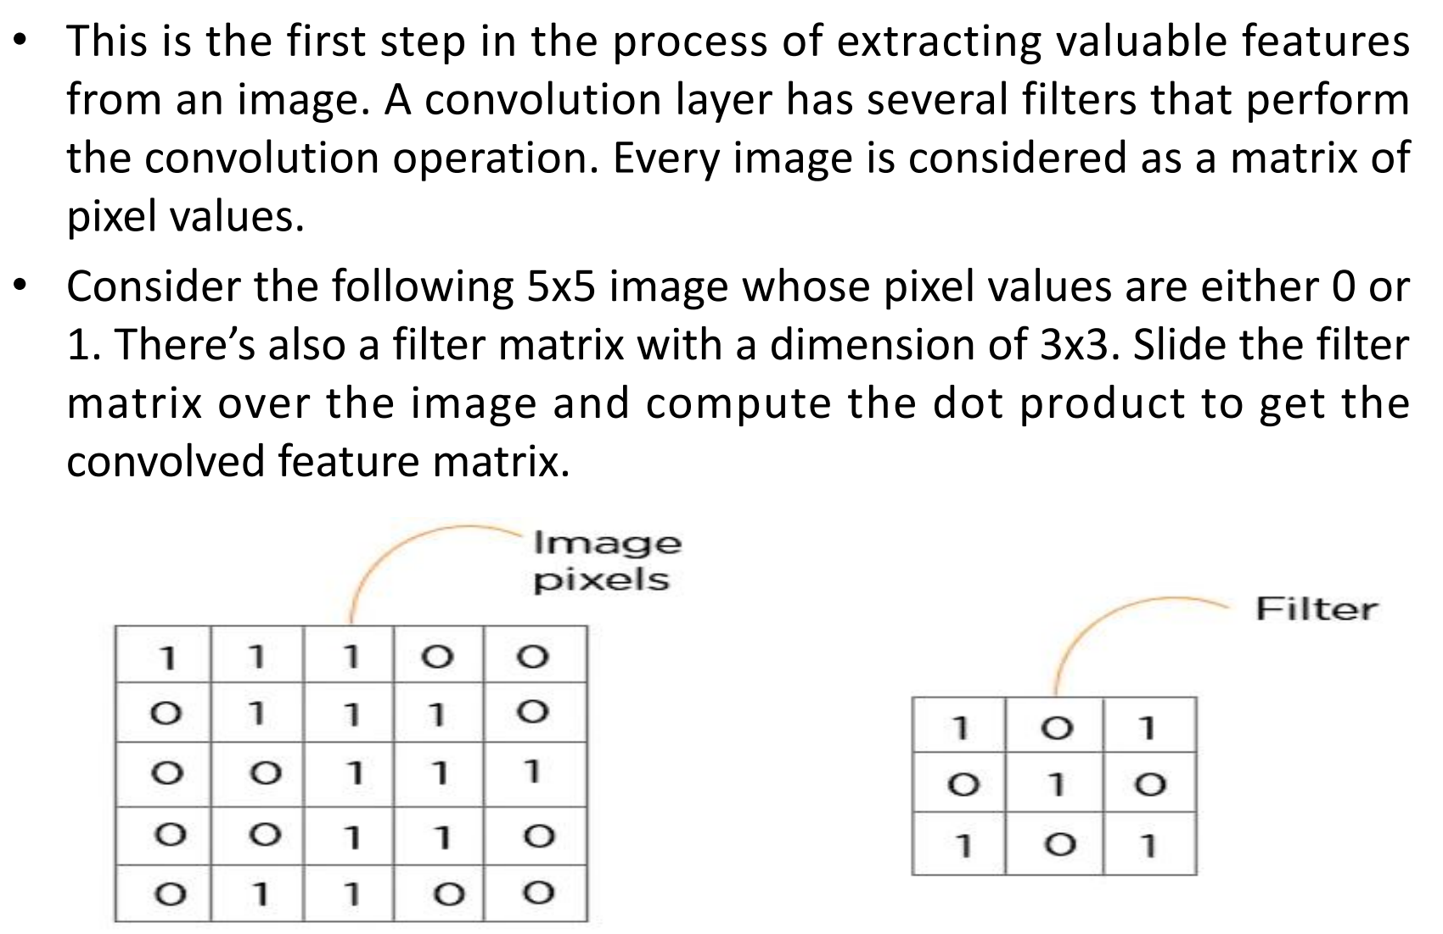
1. Convutional Layer

Slide 7
Features
Parameter sharing: a feature detector (such as a vertical edgedetector) that’s useful in one part of the image is probably useful in another part of the image.
Sparsity of connections: in each layer, each output value depends only on small number of inputs.

Slide 8
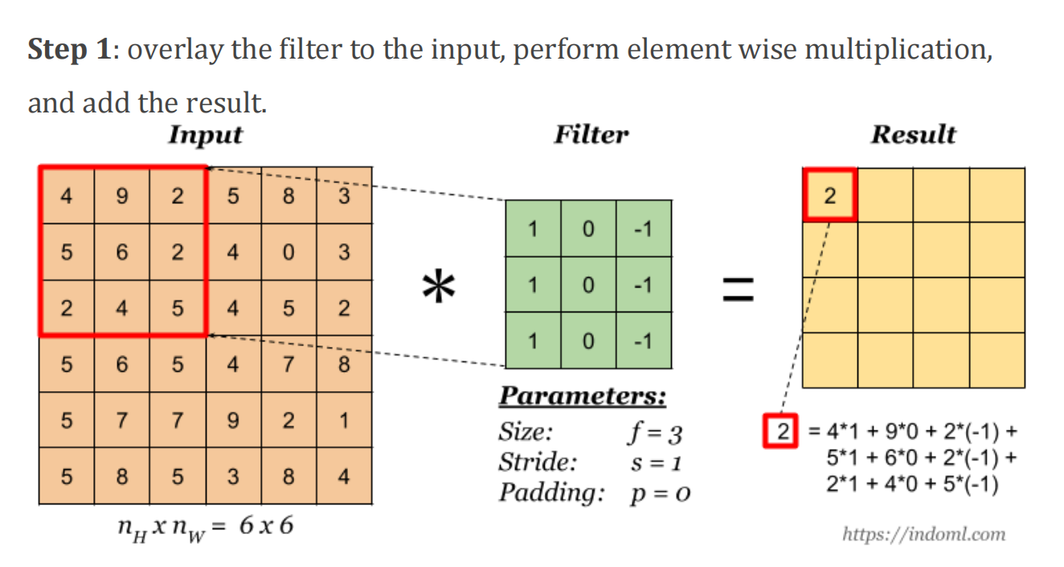
Basic Convolutional Operation

Slide 9
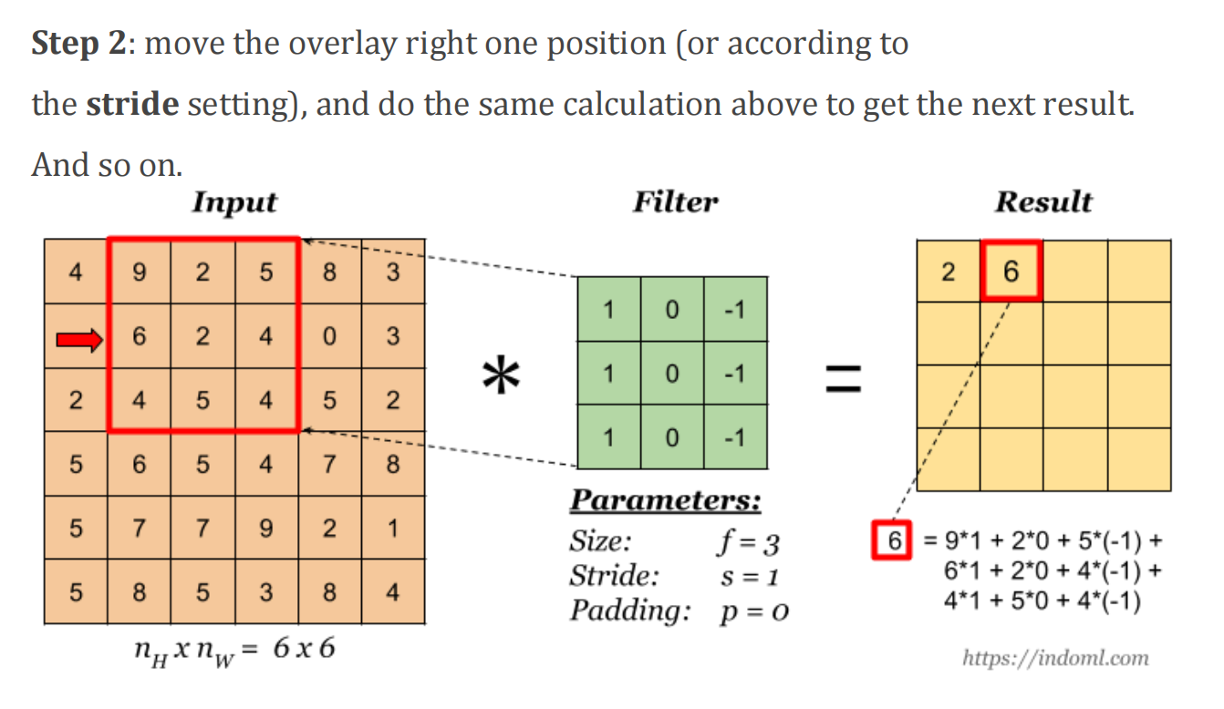
Basic Convolutional Operation
The total number of multiplications to calculate the result above is (4 x 4) x (3 x 3) = 144

Slide 10
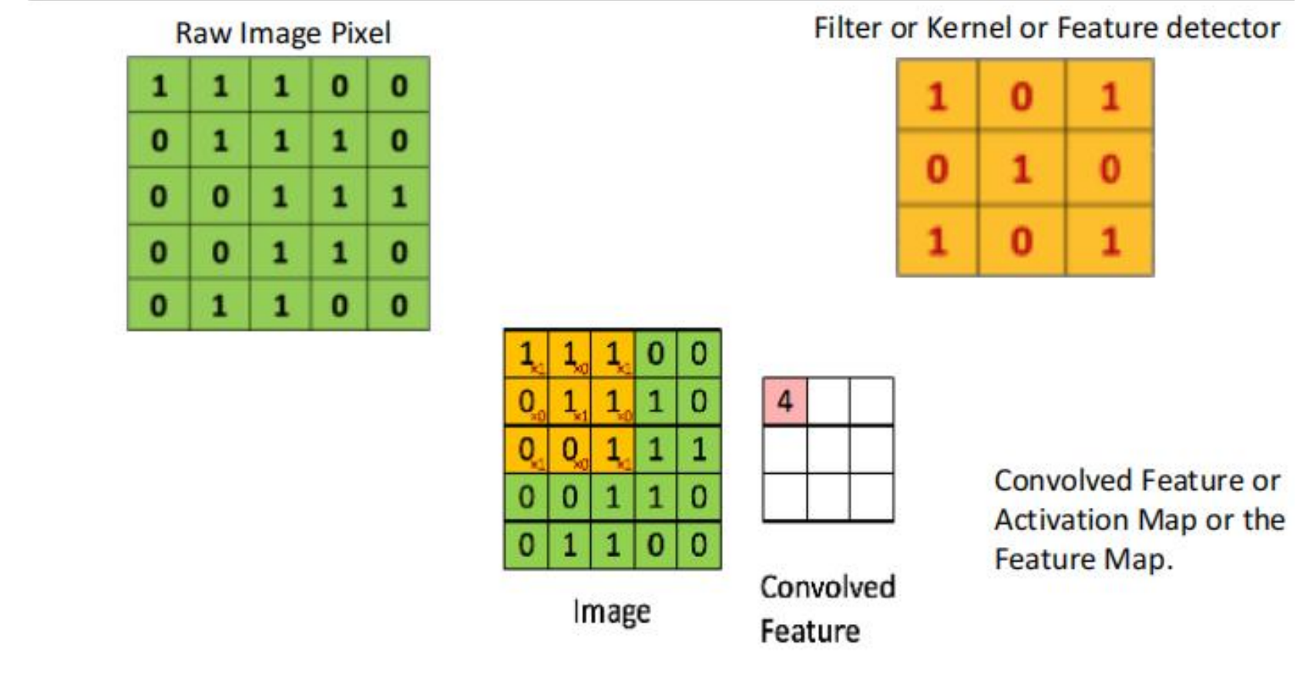
Convolutional Operation - Again

Slide 11
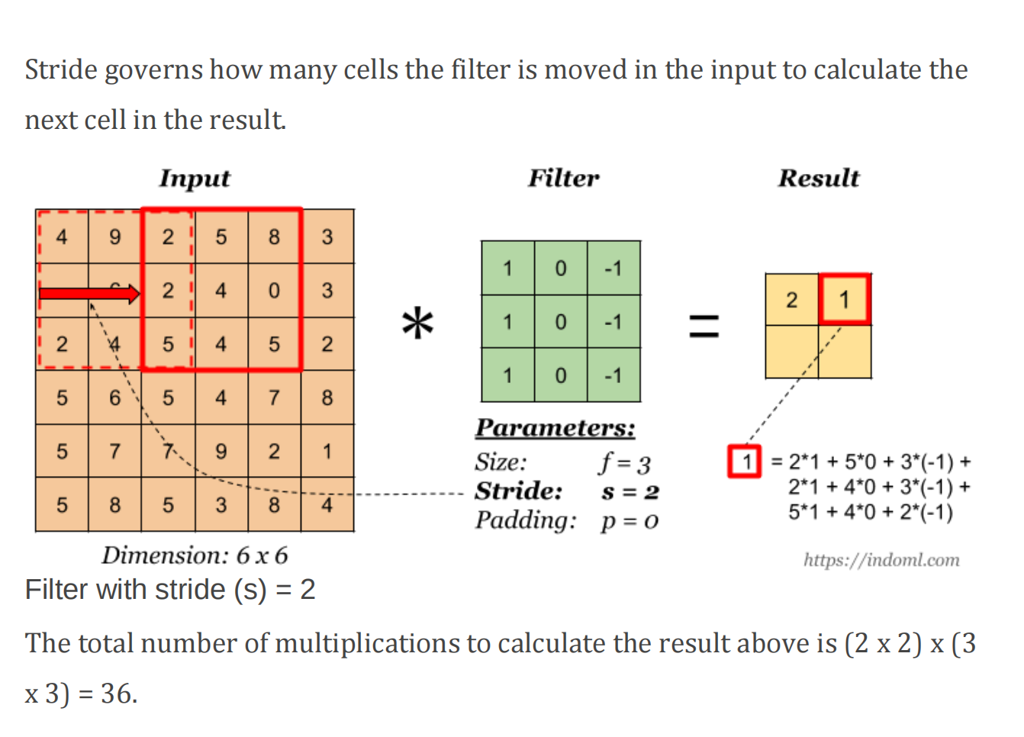
What is Stride ?

Slide 12
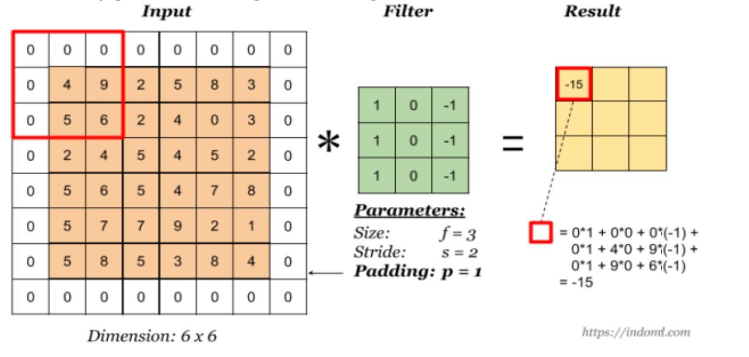
What is Padding ?

Slide 13
Some padding terminologies:
“valid” padding: no padding.
“same” padding: padding so that the output dimension is the same as the input.

Slide 14
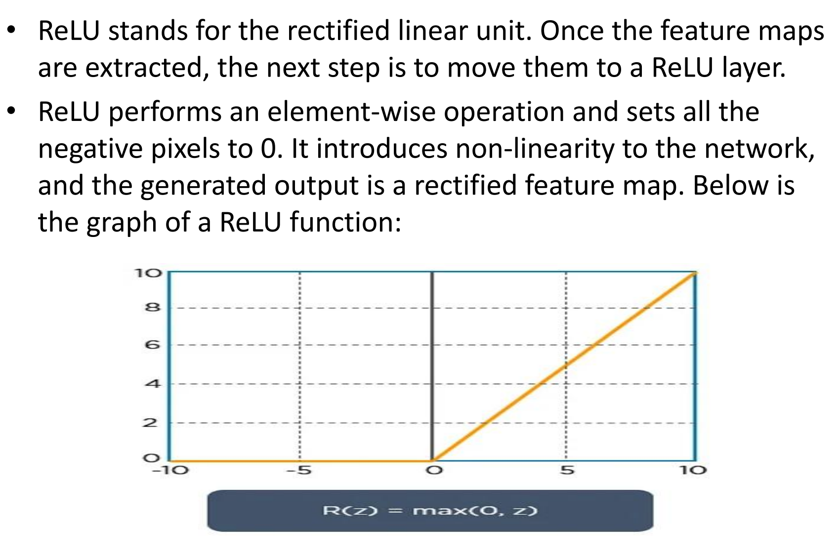
Relu Layer

Slide 15
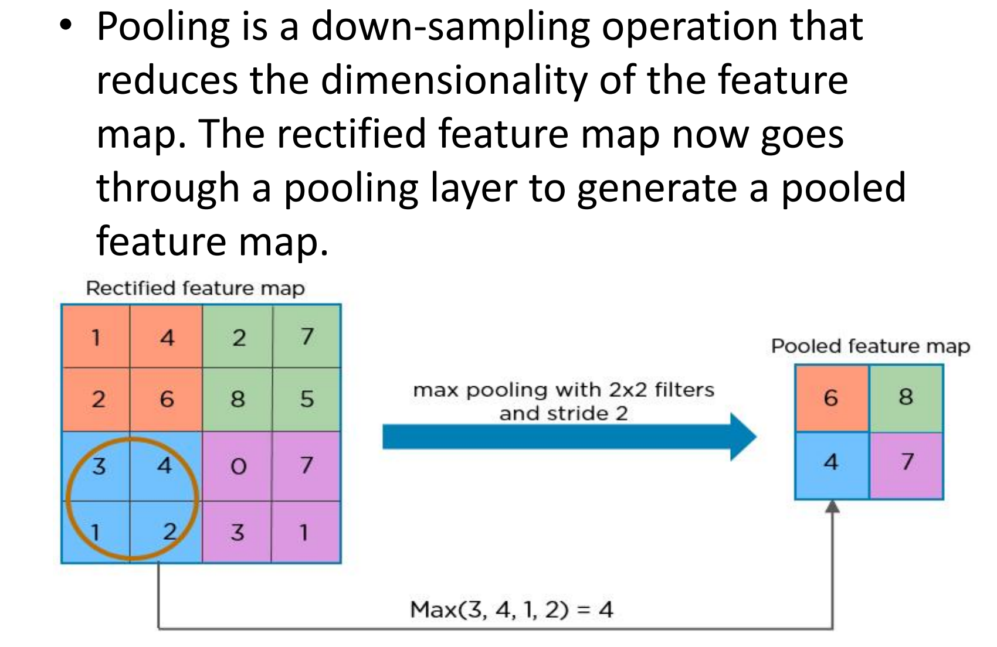
Pooling Layer

Slide 16
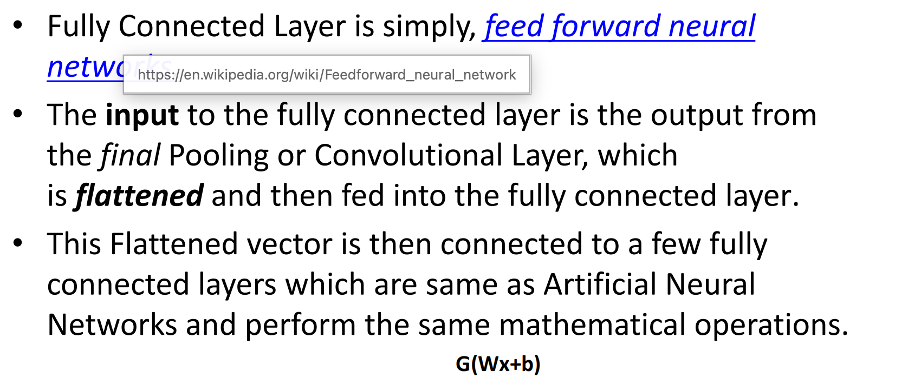
Fully Connected Layer

Slide 17
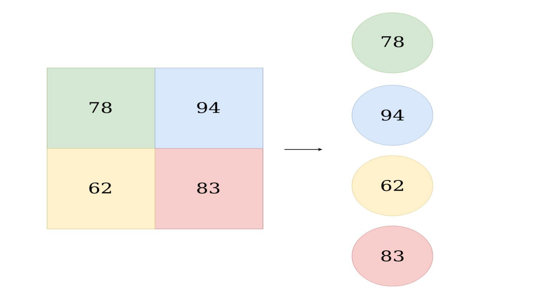
Daigram of Fully Connected Layer to Input for ANN

Slide 18
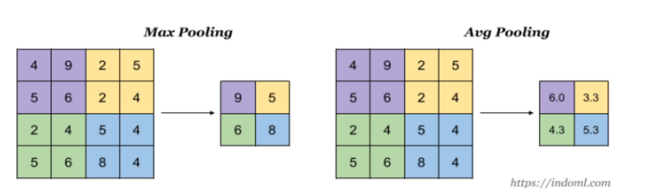
Types of Pooling

Slide 19
Thank You
Vraj Suratwala
Department of ICT, VNSGU

